Slide 1
Kurumsal Mimarlar ve Gelistiriciler için Dijital Tanımlayıcı ve Kimlik Bilgilerinin Kullanımı Baslangıç Egitimi Getting Started with Digital Identifiers and Credentials for Enterprise Architects & Developers
Michael Herman Self-Sovereign Blockchain Futurist, Architect, and Developer Hyperonomy Digital Identity Lab Parallelspace Corporation
ALBERTA, Canada
#indygsgea UKTAS/uktas2019 belgem.io

Slide 2
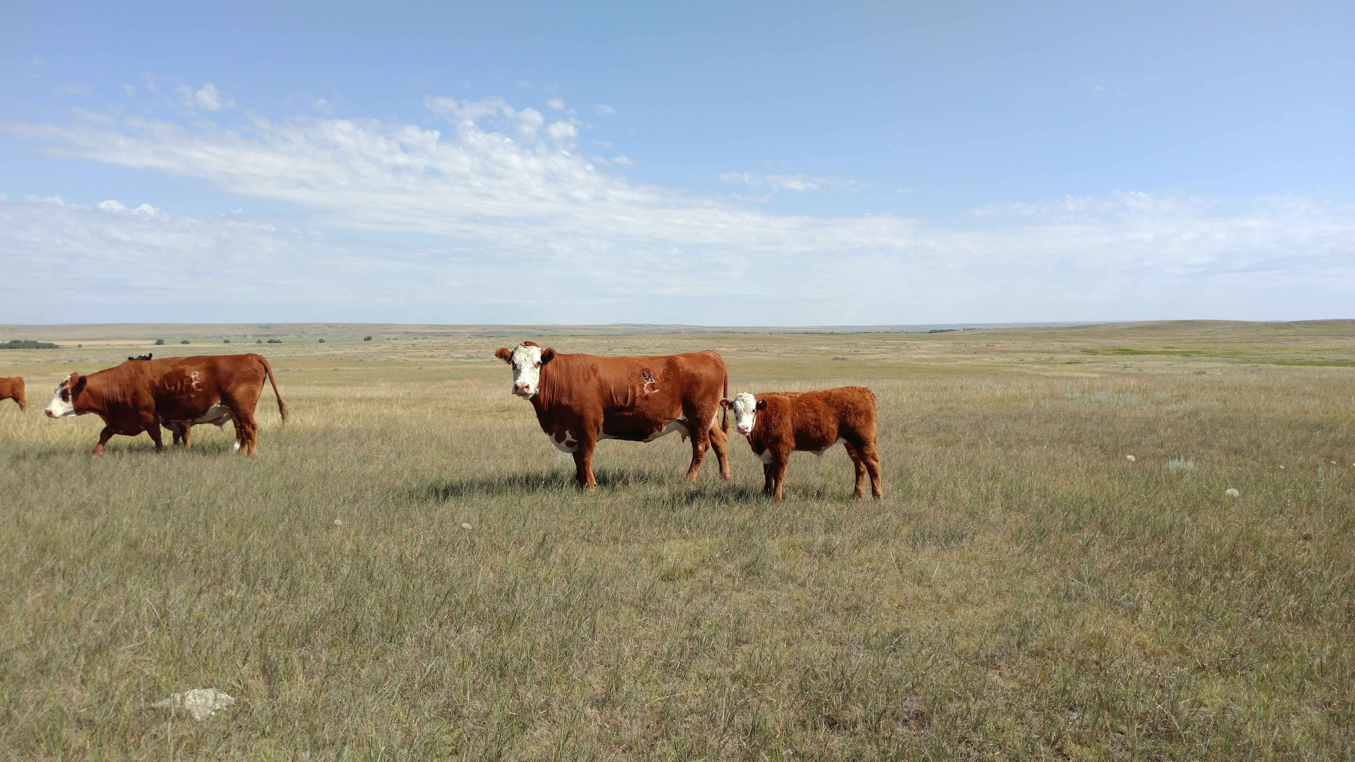

Michael Herman Self-Sovereign Blockchain Futurist, Architect, and Developer Hyperonomy Digital Identity Lab Parallelspace Corporation Alberta, CANADA
Trusted
Digital
Web
R
C
Left Rib

Slide 3

Although some days I feel like this…

Slide 4
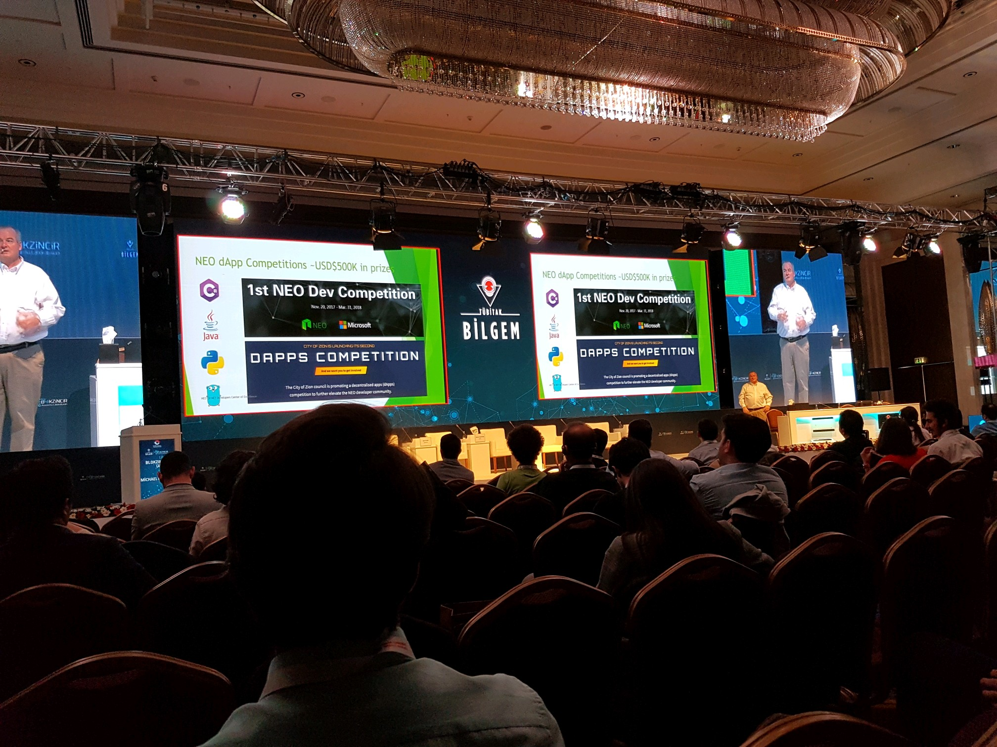

Slide 5
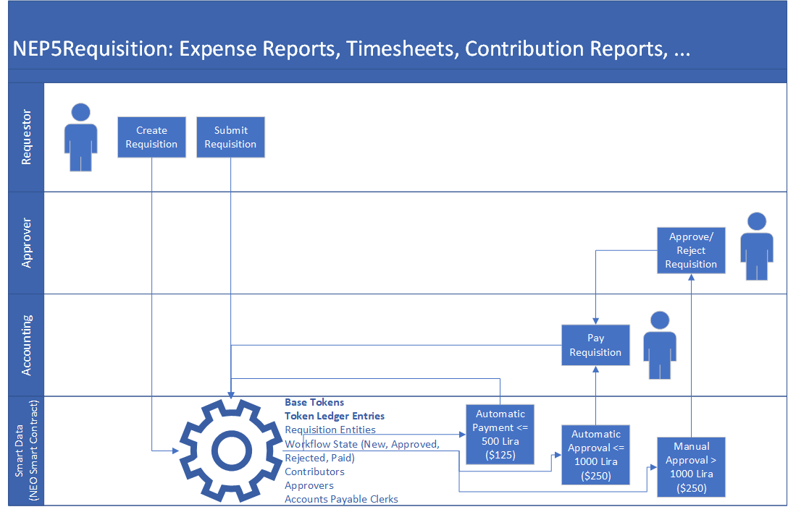
Think Deeply about the Smart Economy “Future world where the boundary between real assets in the physical world and digital assets in the digital world has been removed.” [Malcolm Lerider]
1. create & submit
transfer
ATrzHaicmhRj15C3Vv6e6gLfLqhSD2PtTr
AK2nJJpJr6o664CWJKi1QRXjqeic2zRp8y
AZ9Bmz6qmboZ4ry1z8p2KF3ftyA2ckJAy
ATrzHaicmhRj15C3Vv6e6gLfLqhSD2PtTr
AK2nJJpJr6o664CWJKi1QRXjqeic2zRp8y
AZ9Bmz6qmboZ4ry1z8p2KF3ftyA2ckJAy
AZ9Bmz6qmboZ4ry1z8p2KF3ftyA2ckJAy
NEP5 / ERC20
Tokens
ATrzHaicmhRj15C3Vv6e6gLfLqhSD2PtTr
NEP5 Requisition
Proposal
1. create & submit
AK2nJJpJr6o664CWJKi1QRXjqeic2zRp8y
3. pay
2. approve/reject/reroute
transfer
transfer
3. pay
2. approve/reject/reroute
Smart
Data

Slide 6
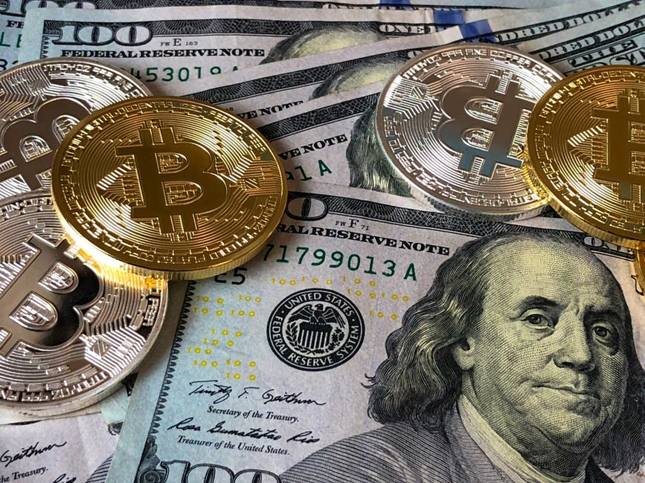
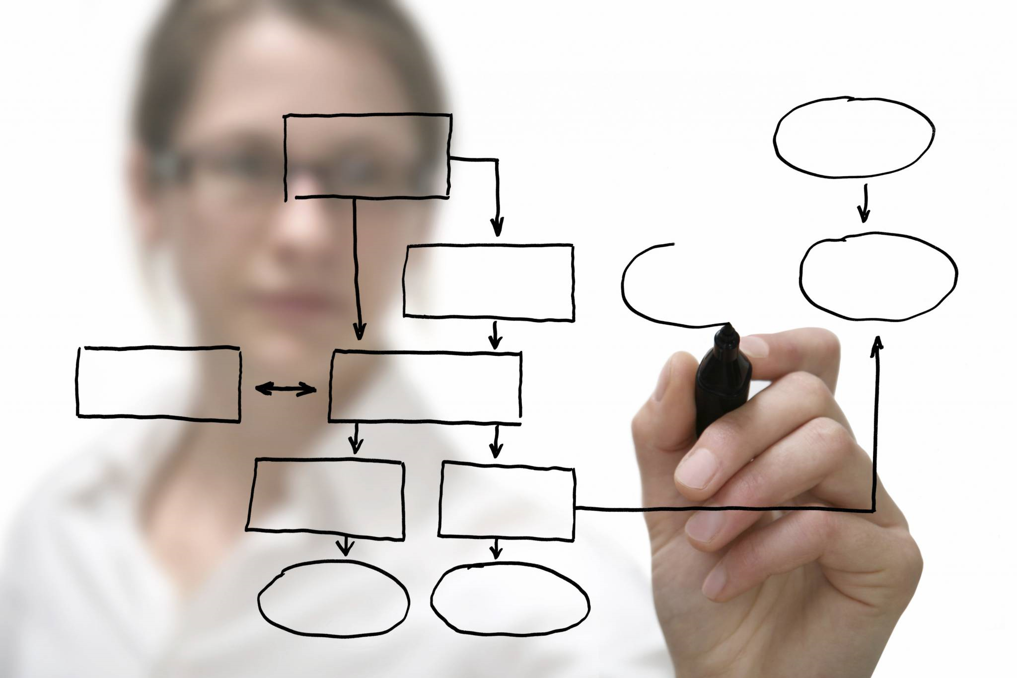
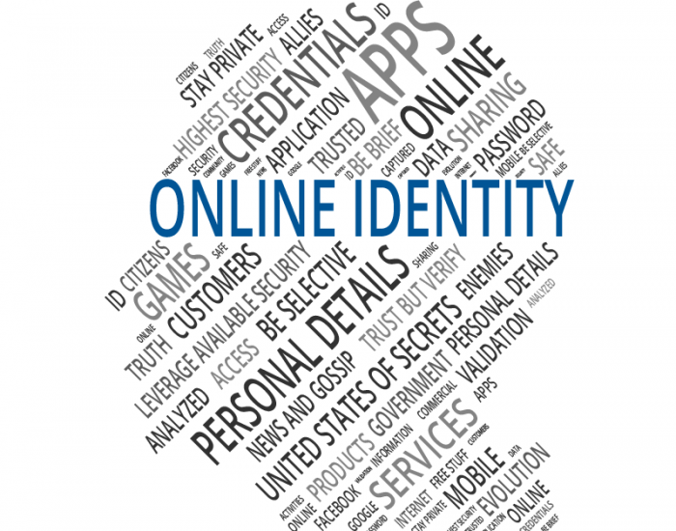
Trusted Digital Web
Trusted
Digital
Web
Fully Integrated Experience
DIGITAL IDENTITY
Decentralized Currency
(cryptocurrency)
Decentralized Business Apps
(business processes)
Decentralized Digital Identity
(people, organizations, things,
& business documents)

Slide 7
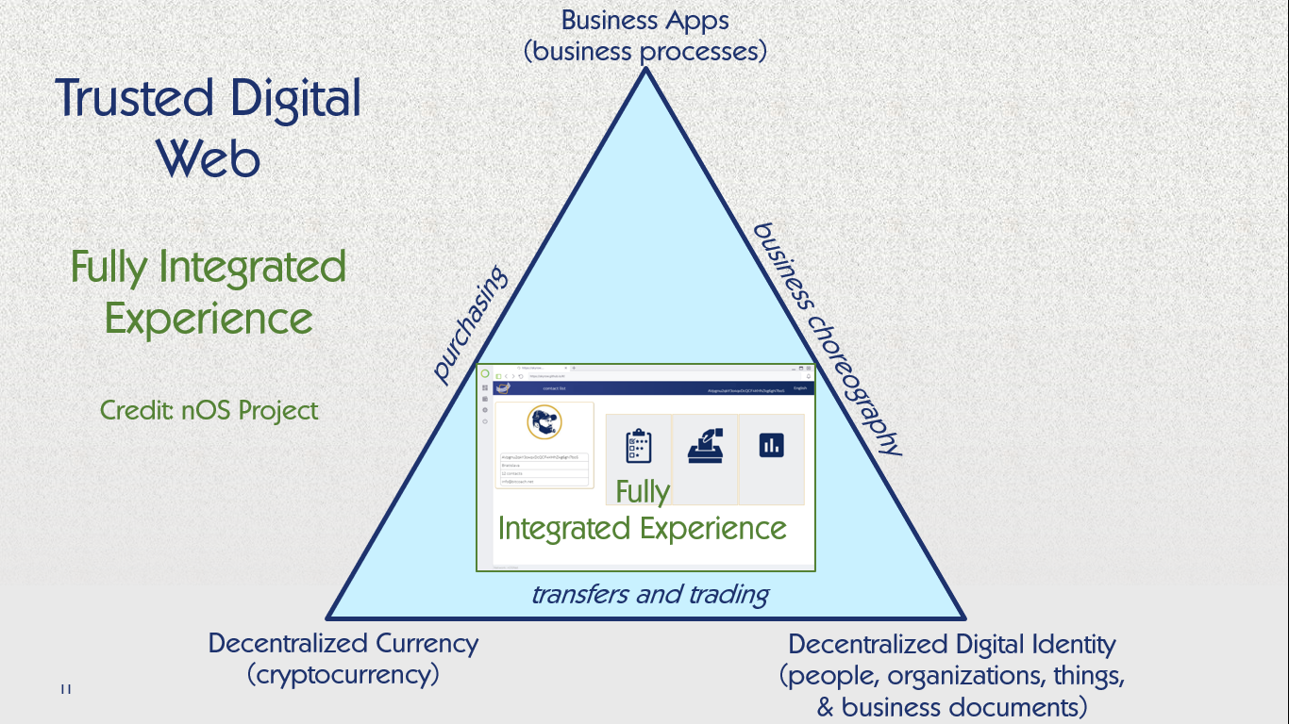

Slide 8
Training Goals for Today
Target audience
Blockchain Architects and Developers interesting in learning more about Digital Identity
“Making software easy to understand – any easy for you to explain to others”
Level
Awareness and Basic Knowledge of Digital Identity concepts
User Story
“Alice buys a car” explained in a way that makes sense for Enterprise Software Developers
“Appetizer” for Mike Lodder’s Hyperledger Aries Dev session

Slide 9
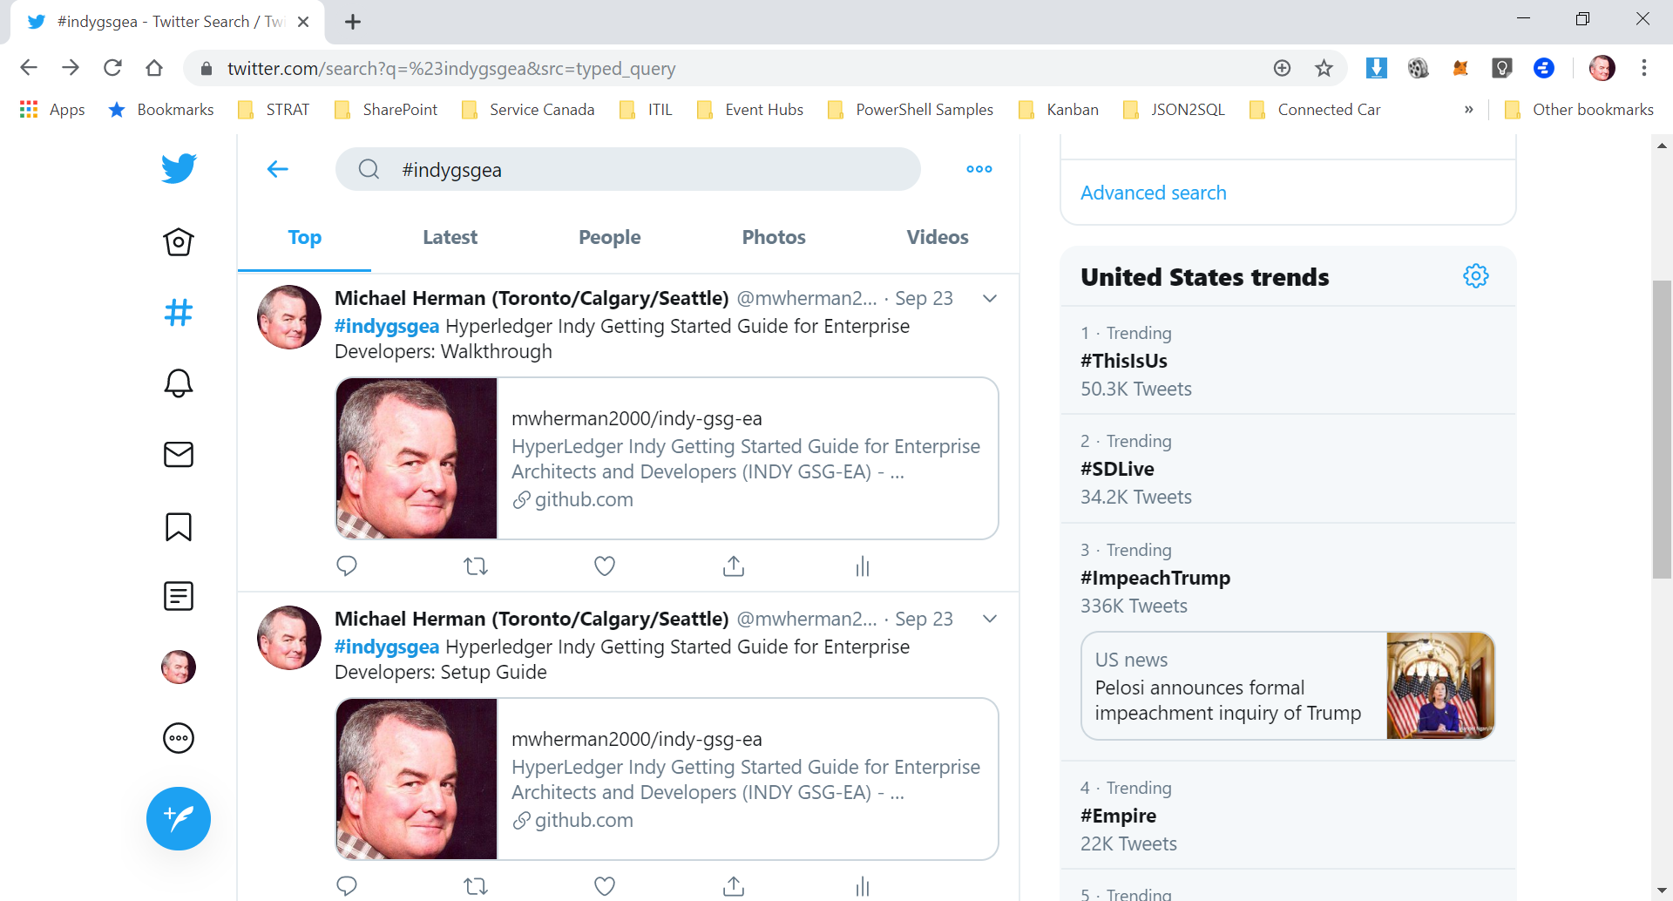
Resources
Can be found by searching Twitter for: #indygsgea

Slide 10
Core Concepts
Subjects
Real (or Virtual) Subjects
Personas
Digital Subject
Digital Identities
Digital Identifiers (DIDs)
Digital Identities (Verifiable)
Credentials (Verifiable)
Claims
Profiles
Verifiable Subject

Slide 11
Subjects
Unique Subject
A Unique Subject is any unique and specific non-fungible object in the Physical or Digital Universe
a person, a place, a thing, an organization, digital visual or audio composition, business document, photo of a piece of toast, etc.
Digital Subject (Subject)
A Digital Subject (aka Subject) is a unique digital representation of a Unique Subject
More specifically, a particular Persona of a Unique Subject.

Slide 12
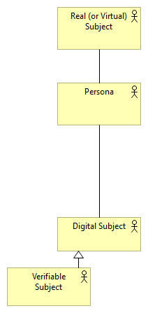
Subjects
Michael Herman
The Person
Self-Sovereign Blockchain Architect
Self-Sovereign Blockchain Developer
Alberta Canada Cattle Rancher
Father
Farm Producer (Rancher) in Alberta, Canada
Issued a Alberta Farm Fuel Tax Exemption Certificate

Slide 13
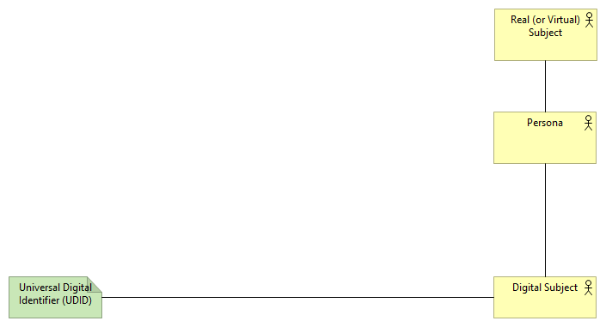
Digital Identifiers (DIDs)
Start with did:
Followed by 1 or more DID Methods
Followed by a Method-defined unique identifier string
Example: did:neonation:123-456-789
Example: did:usergroups:developers:abc12345678

Slide 14
Digital Identities
A Digital Identity is a set of Claims made by one Digital Subject about itself or another Digital Subject [The Laws Of Identity]
A Digital Identity is associated with one or more Digital Identifiers (DIDs).
A Claim is any data associated with a Digital Identity by way of a DID
A Claim is a name-value pair representing a datum associated with a DID
Preferably, Claim data and the Claims' relationships to a Digital Identity are represented (persisted) in a manner that is:
immutable, auditable, verifiable, historized, and permanent
A set of Claims is called a Credential
A collection of Credentials is called a Profile

Slide 15
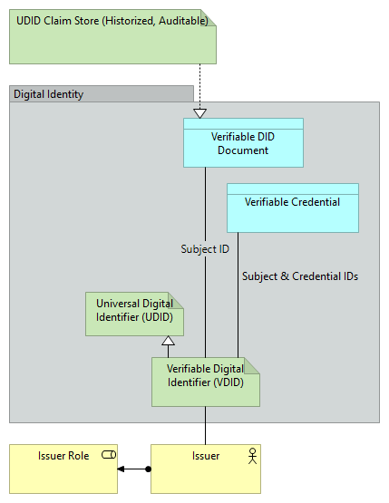
Digital Identities

Slide 16
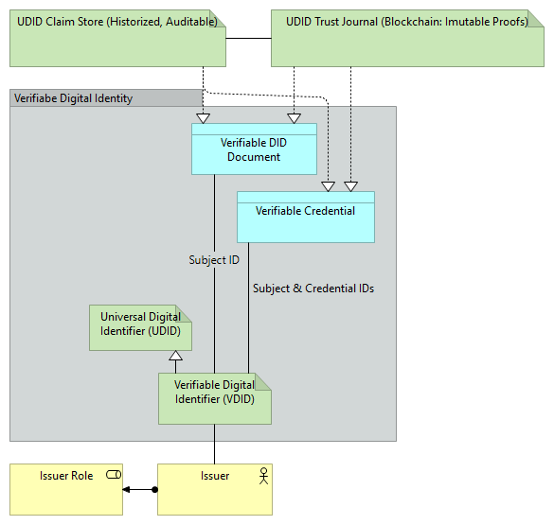
Verifiable Digital Identities

Slide 17
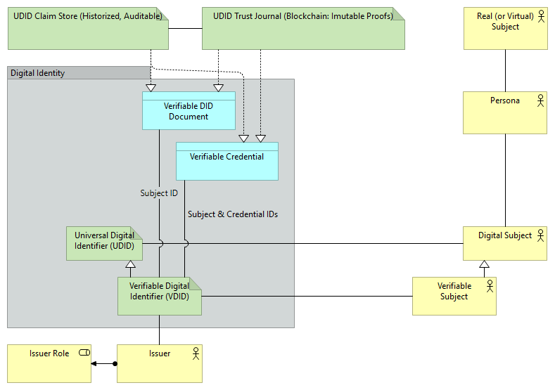
Verifiable Subject

Slide 18
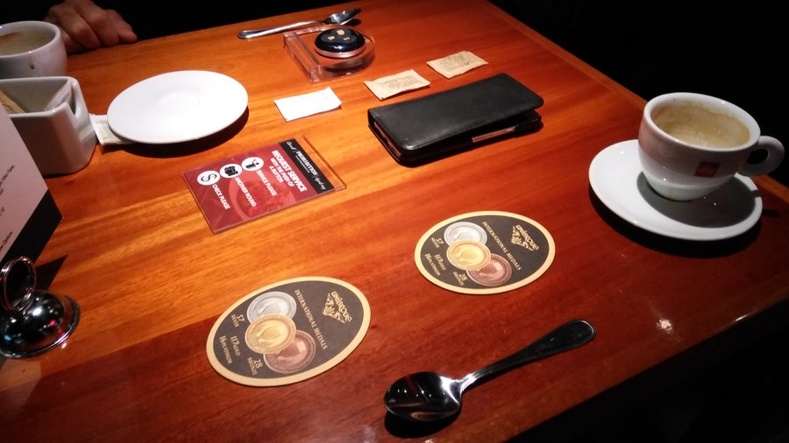
Credit: Lunch with Marc Aniballi / Toronto

Slide 19
Hyperledger Indy Getting Started Guide for Enterprise Architects and Developers

Slide 20
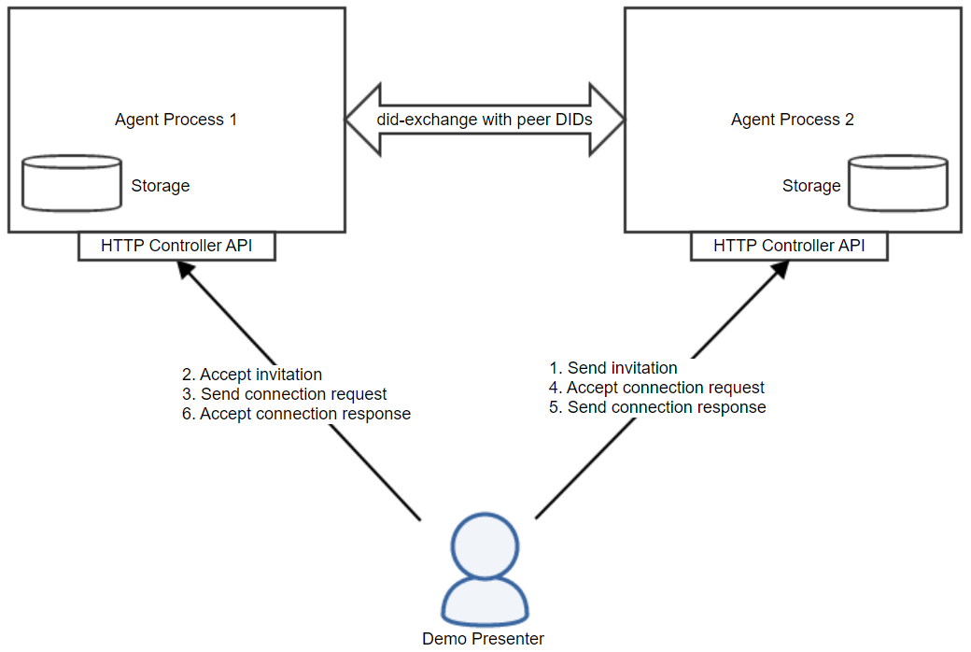
Normal Indy-Aries Demo/Training Scenario
See Mike Lodder’s Session
which follows after mine

Slide 21
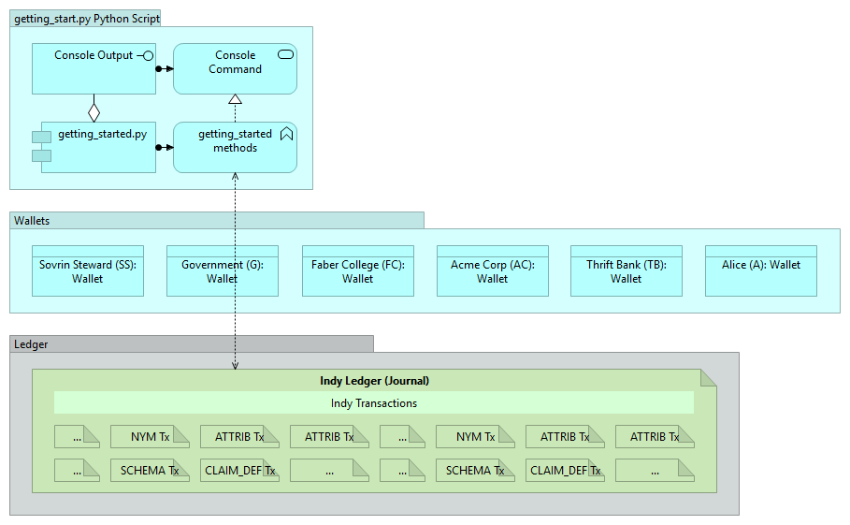

Slide 22
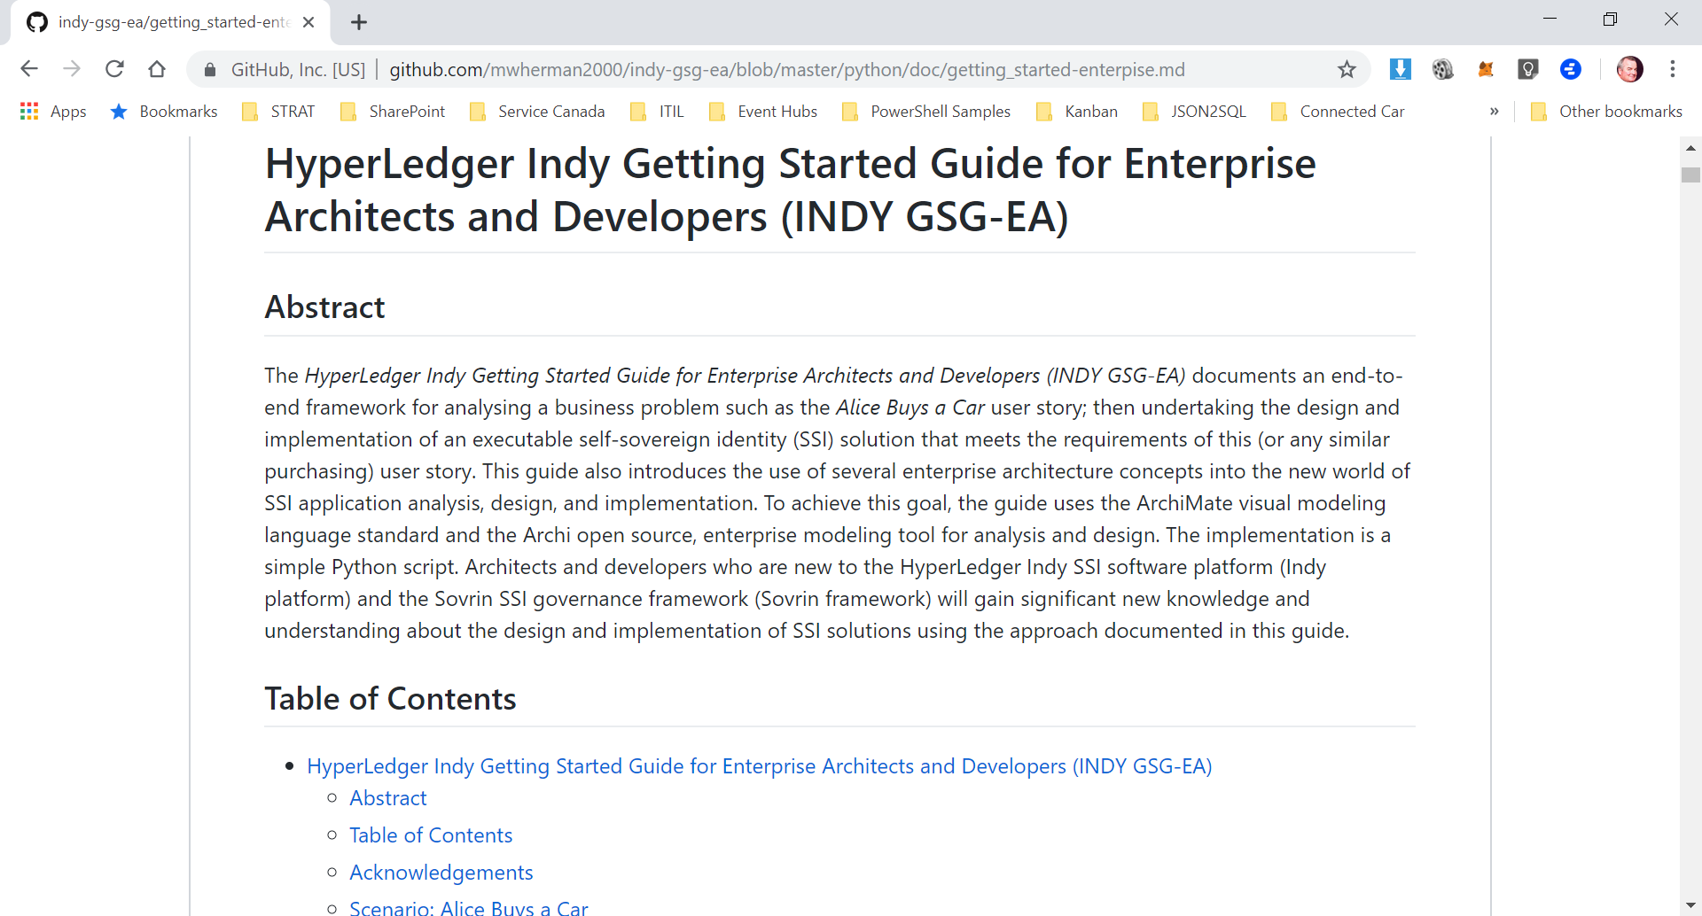
#indygsgea

Slide 23
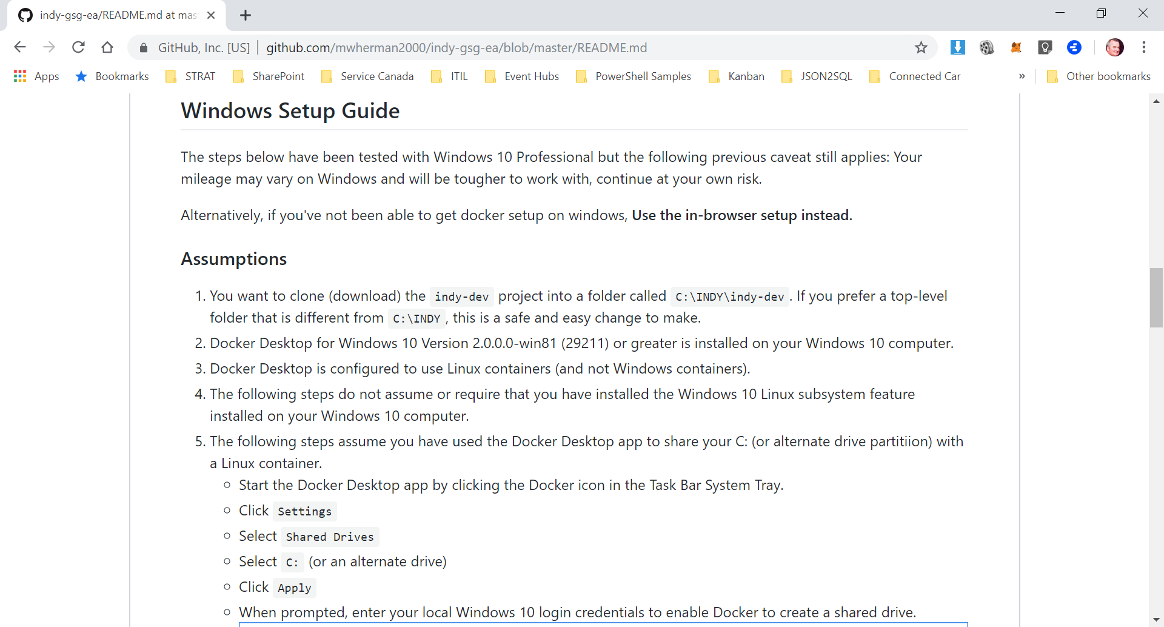
#indygsgea

Slide 24
INDY-GSG-EA User Story: Four Use Cases
Alice wants to buy a car - a bright red Lamborghini® - from Carter's Cars.
To purchase the car from Carter's Cars, Alice needs to take out a loan from Thrift Bank for the entire purchase price.
To get the loan from Thrift Bank, Alice needs to find a job (Alice is currently unemployed) and present a job certificate from her employer to Thrify Bank verifying her employment, salary level, length of service, etc.
To find a job, Alice applies as a candidate for a position at Acme Corp. To apply for a job at Acme Corp, Alice needs to include a verifiable copy of her transcript from Faber College (from where she graduated with her Bachelor's degree).

Slide 25
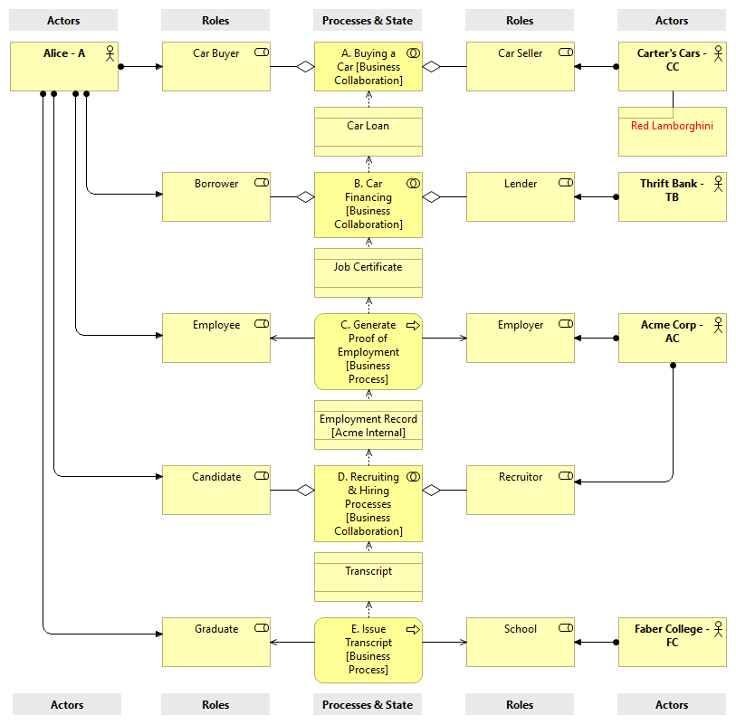
Workflow
Actors
Business Roles
Processes and Subprocesses
State (Artifacts)
Business documents represents a “credentials”

Slide 26
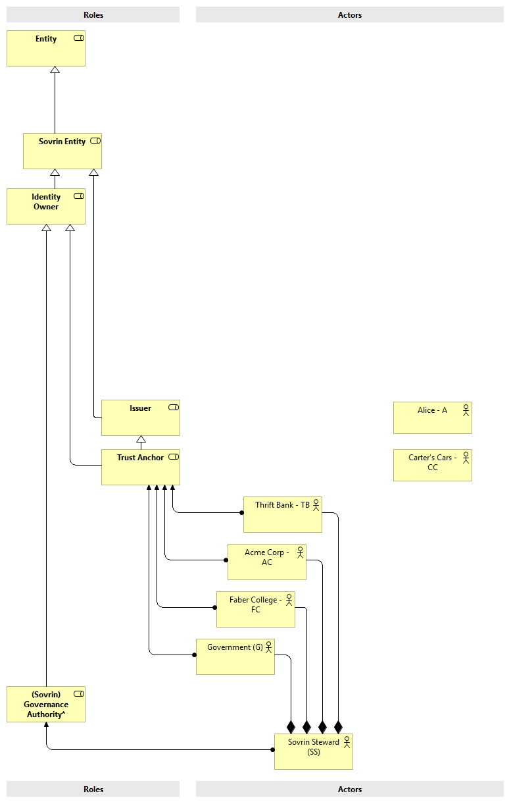
Actors

Slide 27
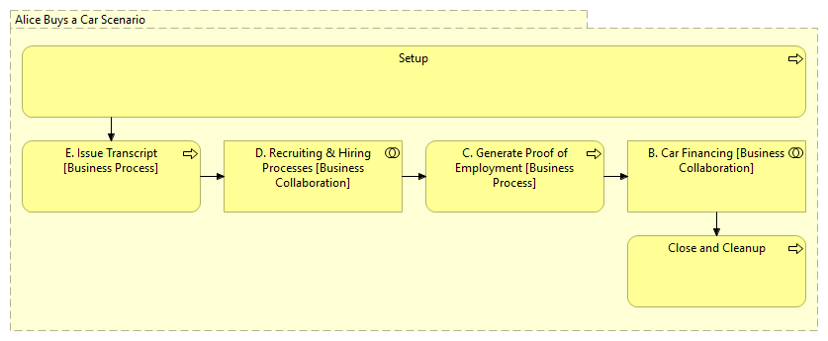
Business Process Analysis

Slide 29
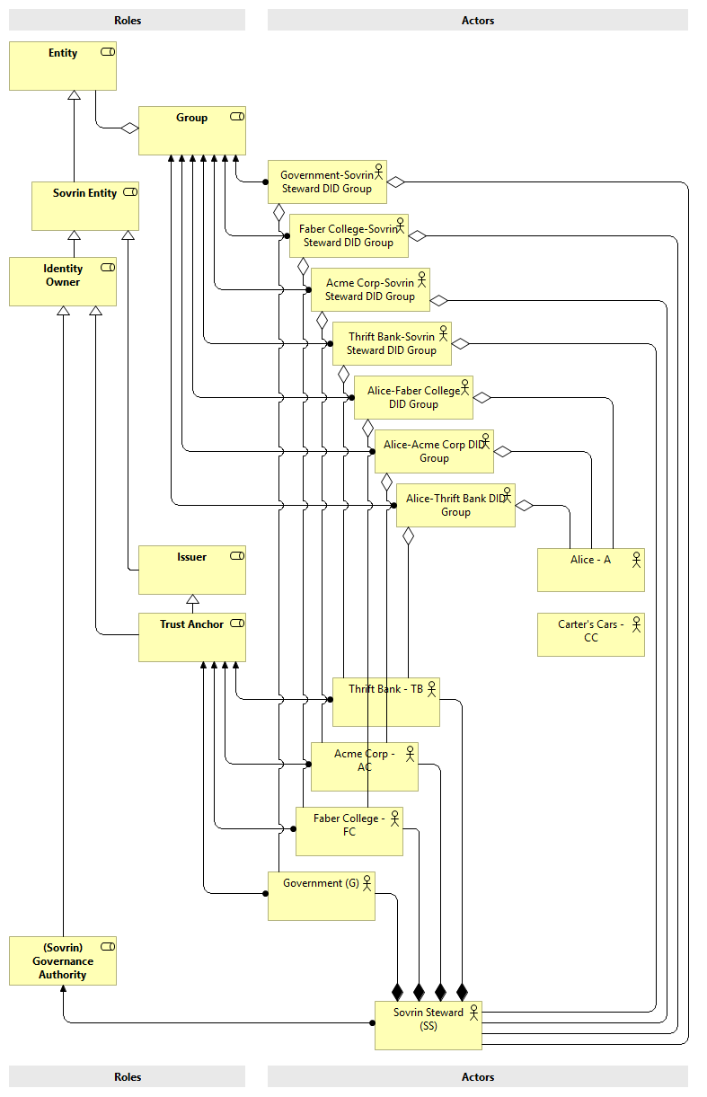
Data Model
Roles
Groups
Actors
Based on Sovrin Glossary

Slide 30
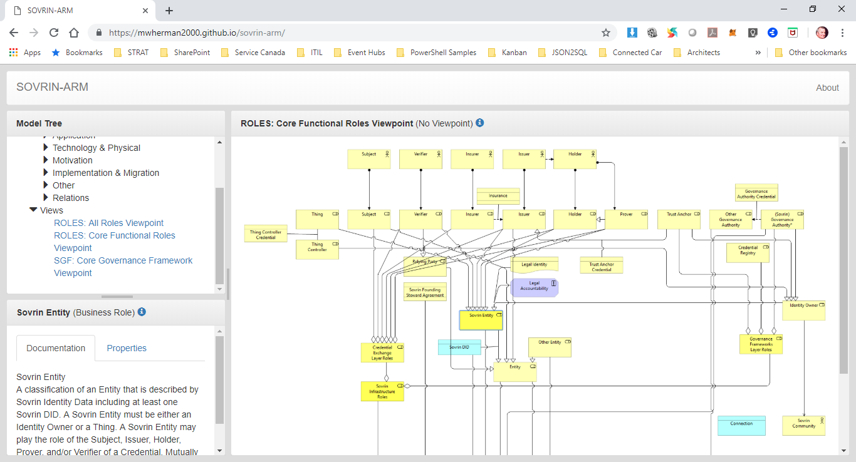
Sovrin Glossary and Sovrin ARM (#indygsgea)

Slide 31
Walkthrough
https://github.com/mwherman2000/indy-gsg-ea/blob/master/python/doc/getting_started-enterpise.md

Slide 32
Indy Getting Started Guide for Enterprise Architects and Developers (INDY GSG-EA) Value Add
Tested setup and execution process
Four highly-correlated artifacts
getting_started-numbered.py Script
Numbered Trace File
Communication Diagrams
Getting Started Guide (INDY GSG-EA)
Original getting_started.py
getting_started-numbered.py Script
Numbered Trace File
Communic-ation Diagrams
Getting Started Guide (INDY GSG-EA)

Slide 33
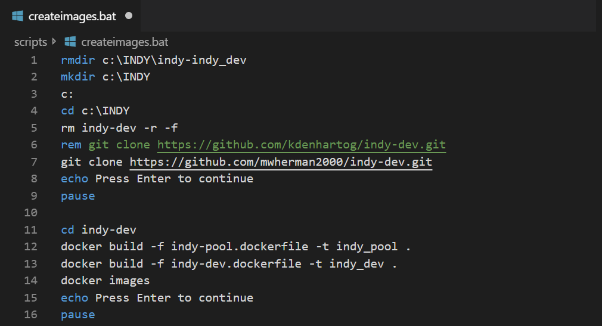
Setup 1/2

Slide 34
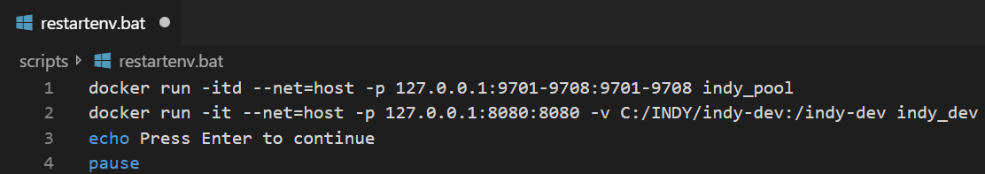
Setup 2/2

Slide 35
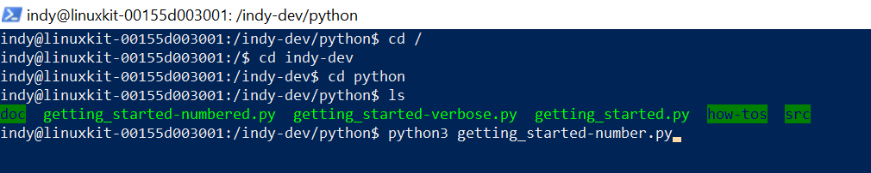
Running the script

Slide 36
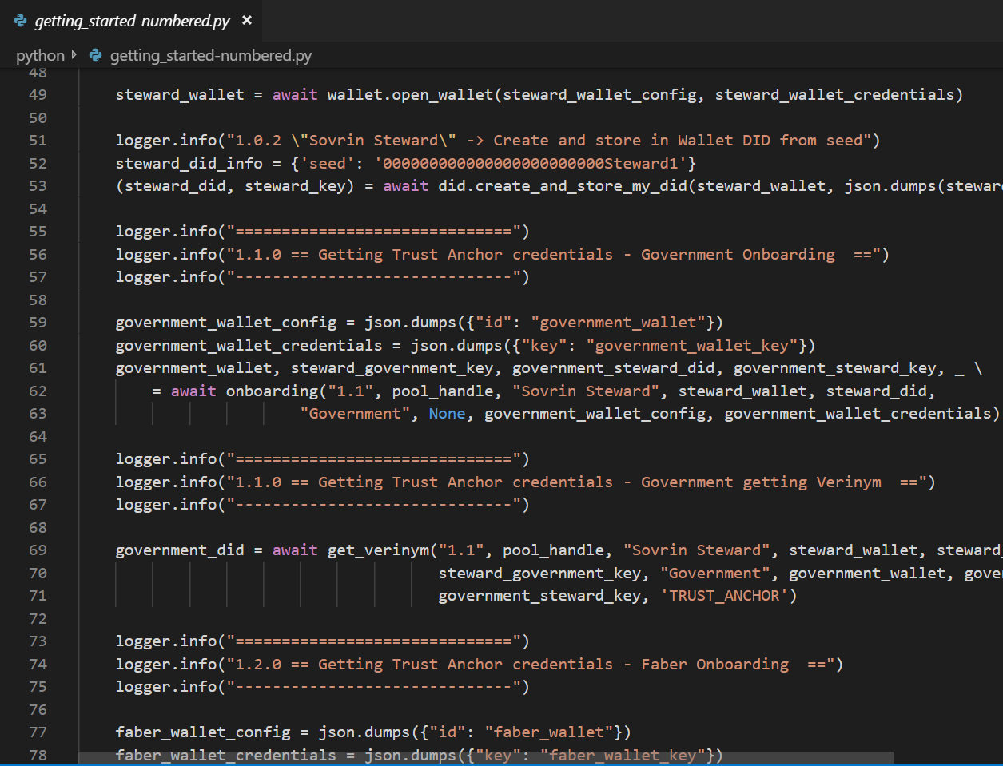
getting_started-numberd.py

Slide 37
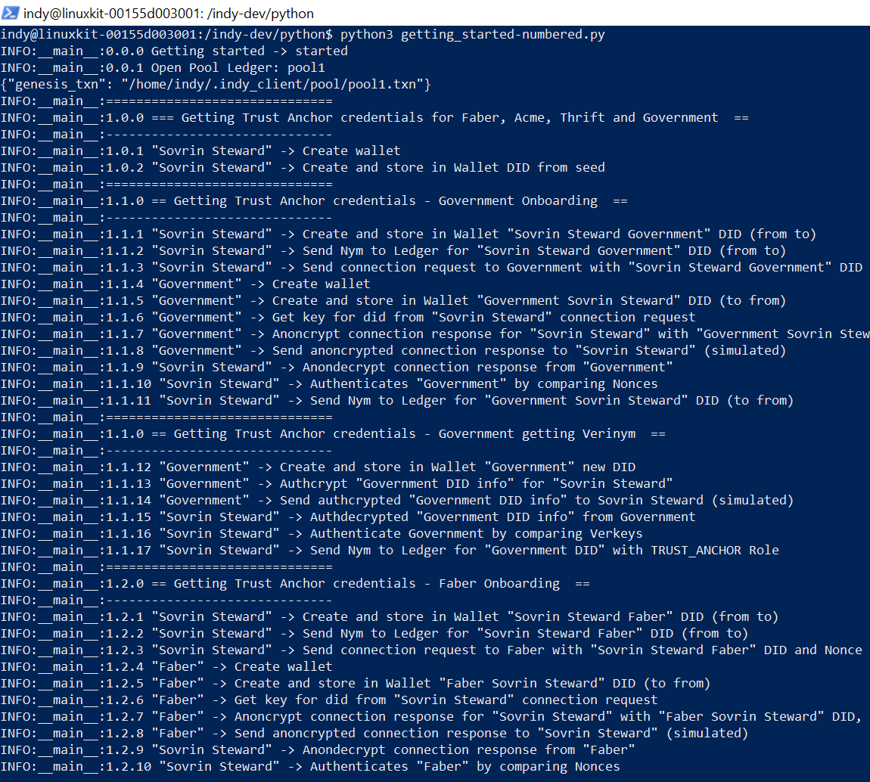

Slide 38
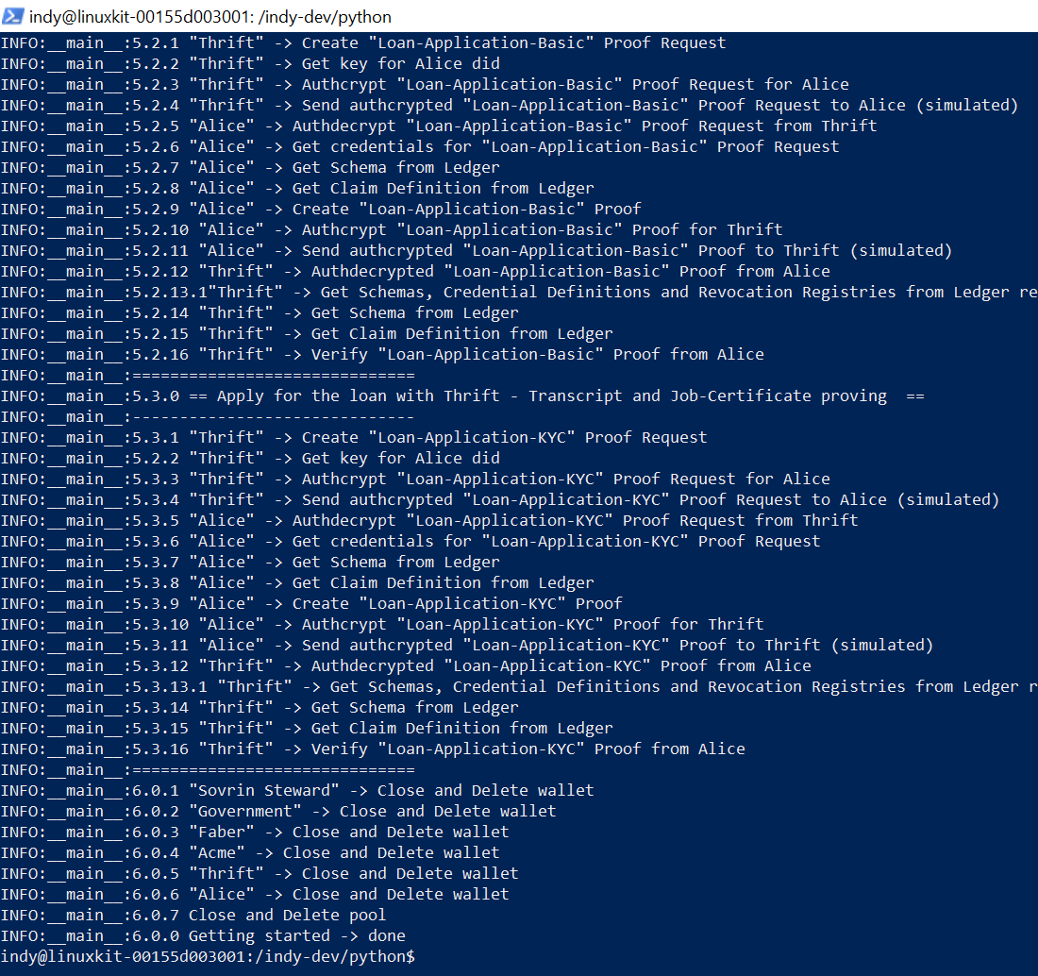

Slide 39
Let’s look at the walkthrough on Github
#indygsgea
https://github.com/mwherman2000/indy-gsg-ea/blob/master/python/doc/getting_started-enterpise.md

Slide 40
Next Steps
Come to Mike Lodder’s session
Hyperledger Aries
Aries Agent
Agent-to-Agent Communications
State-of-the-art Verified Credentials
And more

Slide 41
Final Note
We’re still in the very early market in relation to the use and application of blockchain technology …especially as it relates to digital identity
While there are a number of leading specifications, implementations, and governance frameworks in the market today, I don’t believe they are close to becoming “the industry standard”. They are too new, too unproven, too risky.
Consider other technologies that are already pervasive on the Internet, in your data centers, and in the Cloud (e.g. DNS protocol-based #UDIDServer)

Slide 42
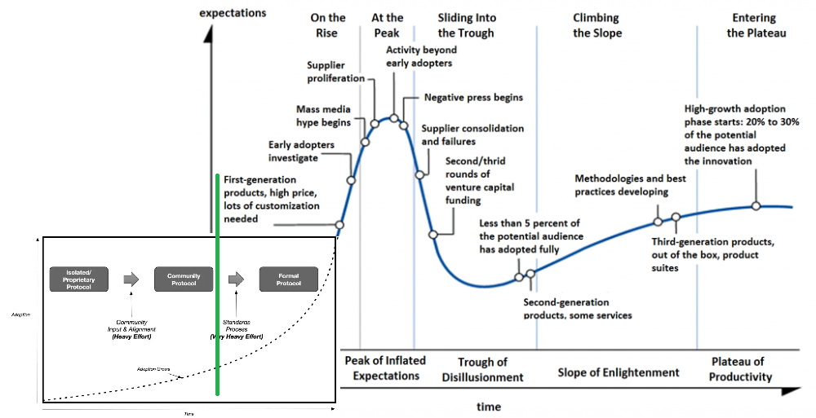
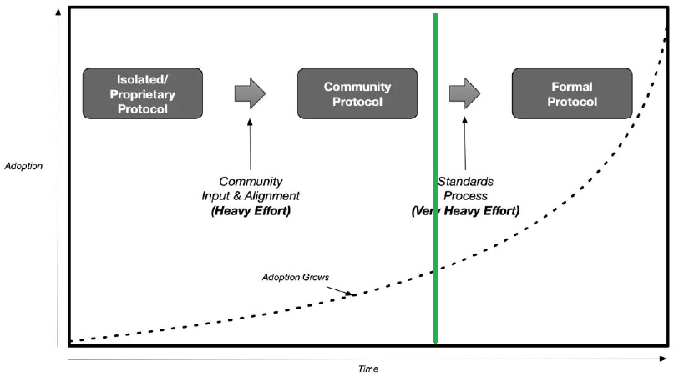
Final Note: Adoption

Slide 43
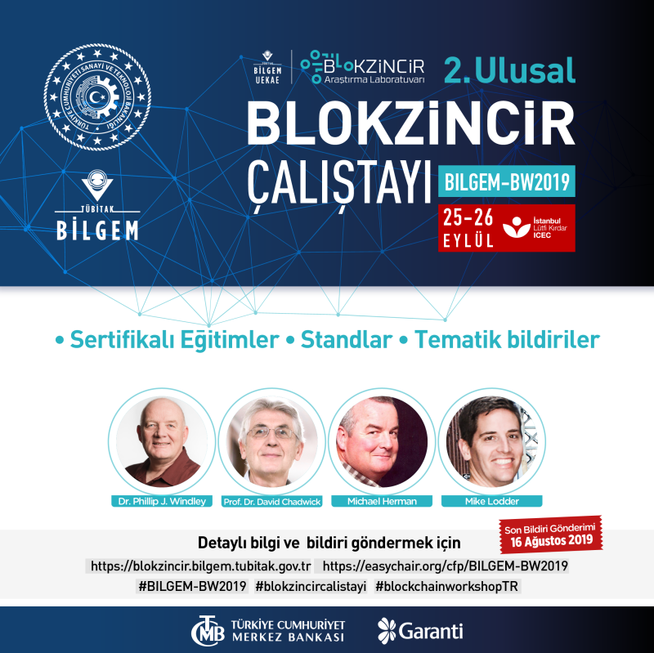
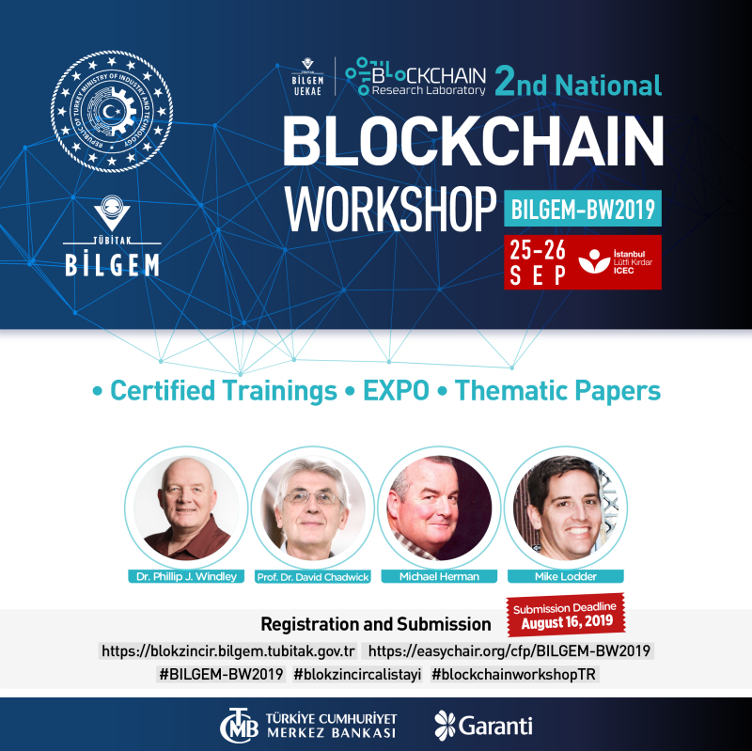

Slide 44
Questions?
mwherman@parallelspace.net

Slide 45
Backup Slides

Slide 46
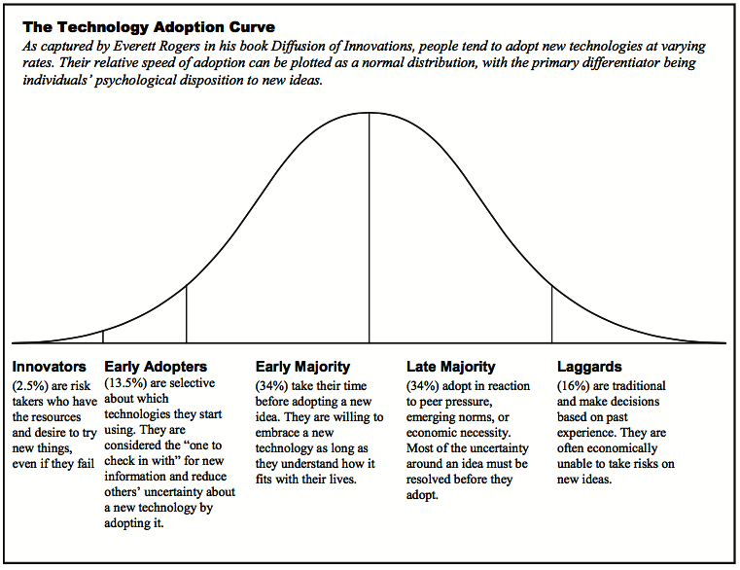
Final Note Early Adopters Marketplace

